Slide 1

Combination Drugs and Multi-target Drug Design
Presented by : Akrishta Sahay

Slide 2
Combination Drugs
Two or more active pharmaceutical ingredients (APIs) combined in a single dosage
Follow network model
Intended to partially inhibit multiple target
Leads to drug synergies
Prevents unwanted compensatory mechanism
Notes:
Drug synergy occurs when drugs can interact in ways that enhance or magnify one or more effects, or side-effects, of those drugs. This is sometimes exploited in combination preparations, such as codeine mixed with acetaminophen or ibuprofen to enhance the action of codeine as a pain reliever.
Combination products, also known as fixed dose drug combinations (FDCs).
The drugs in the combination should act by different mechanisms.
The pharmacokinetics must not be widely different.
Most FDCs have the following demerits:
Dosage alteration of one drug is not possible without alteration of the other drug.
Differing pharmacokinetics of constituent drugs pose the problem of frequency of administration of the formulation.
By simple logic there are increased chances of adverse drug effects and drug interactions compared with both drugs given individually.

Slide 3
Multi-Target Drugs
Drug that “hits” multiple sensitive nodes belonging to a network of interacting targets
Etiological target are acted on together
Rational :
Most of the targets have connections with the other target
Although most drugs are developed based on the single-target strategy, they have diverse targets.
Notes:
Despite the considerable progress in the high-throughput screening method, the rational drug design, and the massive drug-development efforts, the number of successful drugs did not significantly increase during the past decade [1]. The strategy for screening single-target and highly specific agents was widely researched for some time [2], [3]. However, this effort has not been very successful, and undeniably, the bottleneck lies in the area of drug research and development [2]. Until now, there are still not fully effective drugs for treating complex diseases, such as cancer, metabolic diseases, cardiovascular diseases, and neurological diseases. Thus, we believe that the strategy or models used for new drug discovery have to be reconsidered.
Recent developments in biological systems and overall clinical experience have revealed that the single-target drugs may not always induce the desired effect to the entire biological system even if they successfully inhibit or activate a specific target [1], [2], [4], one reason is that organisms can affect effectiveness through compensatory ways. The development of diseases, particularly the complex ones, involves several aspects. Thus, scientists have recently proposed the multi-target drug design concept.
The total number of sampled new molecular entities (NMEs) approved by the U.S. Food and Drug Administration (FDA) from January 2000 to December 2009 has reached 223. The average target number of sampled drugs is 2.5, which is higher than the 1.8 reported by Yildirim et al. using Drugbank data before March 2006 [6], [7]. This increase may partly indicate the rising targets per drug in the recent years.
Reference :
"Polypharmacology". PubMed. MeSH. Retrieved 2015
http://www.omicsgroup.org/journals/the-multi-target-drug-design-era-is-here-consider-it-ddo.1000e101.php?aid=4038

Slide 4
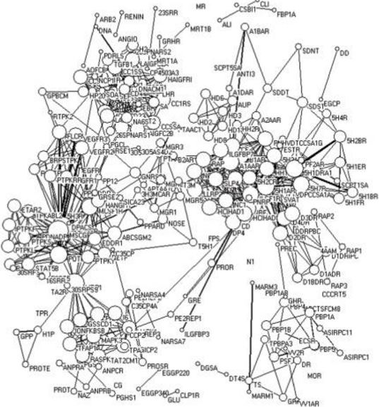
Target- Target Network
Circles indicate the targets
Size of circles represents nodal degree.
Links between the targets represent the number of drugs simultaneously focused by two neighbouring targets.
Thicker ties mean stronger interactions.
Lu, Jin-Jian et al. “Multi-Target Drugs: The Trend of Drug Research and Development.” Ed. Bharat B. Aggarwal. PLoS ONE 7.6 (2012): e40262. PMC. Web. 26 Nov. 2016.
Notes:
Target–target network.The circles indicate the targets and the size of circles represents nodal degree. The links between the targets represent the number of drugs simultaneously focused by two neighboring targets. Thicker ties mean stronger interactions, whereas thinner links represent weaker relationships.

Slide 5
Multi-Target Drugs
Pharmaceutical agents that act on multiple targets or disease pathways
Etiological target are acted on together
Rational :
Most of the targets have connections with the other target
Although most drugs are developed based on the single-target strategy, they have diverse targets.
Notes:
Despite the considerable progress in the high-throughput screening method, the rational drug design, and the massive drug-development efforts, the number of successful drugs did not significantly increase during the past decade [1]. The strategy for screening single-target and highly specific agents was widely researched for some time [2], [3]. However, this effort has not been very successful, and undeniably, the bottleneck lies in the area of drug research and development [2]. Until now, there are still not fully effective drugs for treating complex diseases, such as cancer, metabolic diseases, cardiovascular diseases, and neurological diseases. Thus, we believe that the strategy or models used for new drug discovery have to be reconsidered.
Recent developments in biological systems and overall clinical experience have revealed that the single-target drugs may not always induce the desired effect to the entire biological system even if they successfully inhibit or activate a specific target [1], [2], [4], one reason is that organisms can affect effectiveness through compensatory ways. The development of diseases, particularly the complex ones, involves several aspects. Thus, scientists have recently proposed the multi-target drug design concept.
The total number of sampled new molecular entities (NMEs) approved by the U.S. Food and Drug Administration (FDA) from January 2000 to December 2009 has reached 223. The average target number of sampled drugs is 2.5, which is higher than the 1.8 reported by Yildirim et al. using Drugbank data before March 2006 [6], [7]. This increase may partly indicate the rising targets per drug in the recent years.
Reference :
"Polypharmacology". PubMed. MeSH. Retrieved 2015
http://www.omicsgroup.org/journals/the-multi-target-drug-design-era-is-here-consider-it-ddo.1000e101.php?aid=4038

Slide 6
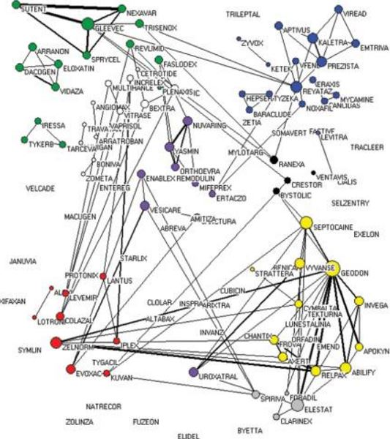
Drug-Drug Network
circles indicate the drugs
Size of circles represents nodal degree.
The links between the drugs represent the number of targets simultaneously focused by the two neighbouring drugs.
Thicker ties mean stronger interactions.
Lu, Jin-Jian et al. “Multi-Target Drugs: The Trend of Drug Research and Development.” Ed. Bharat B. Aggarwal. PLoS ONE 7.6 (2012): e40262. PMC. Web. 26 Nov. 2016.
Notes:
Drug–drug network.The circles indicate the drugs and the size of circles represents nodal degree. The circles of nodes without any line will disappear in the networks because their nodal degree is equal to zero. The links between the drugs represent the number of targets simultaneously focused by the two neighbouring drugs. Thicker ties mean stronger interactions, whereas thinner links represent weaker relationships. Red, alimentary tract and metabolism; Yellow, nervous system; Blue, general anti-infectives systemic; Green, antineoplastic and immunomodulating agents; Purple, genito-urinary system and sex hormones; Grey, respiratory system; Black, cardiovascular system; White, others

Slide 7
Multi-Target Drug Design Strategy
Target ‘sweet spot ’ of drug discovery
Cellular networks and drug target maps
meaning the overlap between pathways
Sweet spot represents those few hundred proteins, which are both part of interesting pathways and are druggable
allow indirect effects via network-contacts of multi-target drugs
Notes:
Sweet spots are set of proteins common on two overlapping pathways.These proteins can be selected using knowledge of cellular networks and drug target maps.

Slide 8
Challenge in Multi-Target Drug Design
Prediction of off-target activities
Solution is off-target screening
Bioassay
Screening against panel of relevant protein
Predictive models
Using drug-target ,drug-side effect data
Predicting activity of drug on side-effect target/off-target based on similarity
Notes:
Drugs are screened using bioassay. However, one can use predictive models to come up with set of proteins to be tested together in bioassay.

Slide 9
Using Drug-Target and Drug-Side Effect Data
Identify overrepresented protein–side effect pairs
Use this to explain actual side effect of drug by looking for protein that are predicted to cause the side effect among drug’s target.
Identify the contributions of certain target classes by filtering the drug targets accordingly
Predicted new target and side-effect relation
Drug- Target Data
Drug side effect data
Notes:
Aim : identification of protein that cause side effect
Example : They were able to predict
and validate in vivo that zolmitriptan (Figure 2), a drug used to
treat migraine targeting serotonin receptors 5-HT-1B and 5-
HT-1D, is responsible for increased pain sensitivity (hyperesthesia)
as a consequence of binding to the off-target 5-HT-7
(26% sequence identity with 5-HT-1B and 5-HT-1D).

Slide 10
Predicting Activity of Drug on Off-Target
Computational strategy based on the evaluation of the similarity of several drugs to sets of reference ligands(known adverse effect)
They were able to predict drug−target interactions confirmed by database annotations or binding assays.
Ligand-based approach used to discover off-target activities of known drugs and rationalize observed adverse reactions
Notes:
They applied a computational strategy based on the evaluation of the similarity of several drugs to sets of reference ligands of targets with previously known associations to adverse reactions.
the histamine H1 receptor was
identified as an off-target of prenylamine (Figure 2), a calcium
channel blocker.35 This activity was associated with sedation, a
reported side effect of this drug. Interestingly, this side effect
was not associated with any of the previously known targets of
Prenylamine

Slide 11
Conclusion
Choose promising target combination
Select target sets of multi-target drugs with help of networks
Prior knowledge is needed for multi-target drug delivery

Slide 12
Reference
Peters, J.-U.; Hert, J.; Bissantz, C.; Hillebrecht, A.; Gerebtzoff,G.; Bendels, S.; Tillier, F.; Migeon, J.; Fischer, H.; Guba, W.; Kansy,M. Can We Discover Pharmacological Promiscuity Early in the DrugDiscovery Process? Drug Discovery Today 2012, 17, 325−335.
Lounkine, E.; Keiser, M. J.; Whitebread, S.; Mikhailov, D.;Hamon, J.; Jenkins, J. L.; Lavan, P.; Weber, E.; Doak, A. K.; Côté, S.;Shoichet, B. K.; Urban, L. Large-Scale Prediction and Testing of DrugActivity on Side-Effect Targets. Nature 2012, 486, 361−367.
Bender, A.; Scheiber, J.; Glick, M.; Davies, J. W.; Azzaoui, K.;Hamon, J.; Urban, L.; Whitebread, S.; Jenkins, J. L. Analysis of Pharmacology Data and the Prediction of Adverse Drug Reactions andOff-Target Effects from Chemical Structure. ChemMedChem 2007, 2,861−873.
Azzaoui, K.; Hamon, J.; Faller, B.; Whitebread, S.; Jacoby, E.;Bender, A.; Jenkins, J. L.; Urban, L. Modeling Promiscuity Based on in Vitro Safety Pharmacology Profiling Data. ChemMedChem 2007, 2,874−880.

Slide 13
Thank You

